Slide 1


Able to Design and Develop Dynamic Websites with PHP

Slide 2
In this section, we will discuss:
Decisions and loops using HTML
Doing Repetitive task with looping
Mixing Decisions and looping with Html
What is a function?
Creating and accessing, String Searching & Replacing String
Formatting String ,String Related Library function
Array - Anatomy of an Array
Creating and accessing index based and Associative array
Looping with Index based array
Looping with associative array using each() and for each ()
Some useful Library functions

Slide 3
In this section, we will discuss:
Working with File and Directories – Understanding File & Directory
Opening and Closing a file. Copying, renaming and deleting a file
Building a text editor. File uploading and Downloading
Using Hidden field, cookies, session
Using query string (URL rewriting)
String matching with regular expression
Pattern matching in PHP, replacing text, splitting a string with regular expression

Slide 4
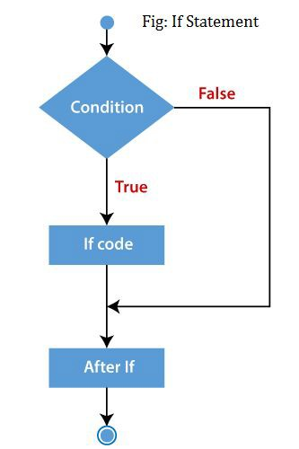
Decisions and loop
Image Source:
https://www.tehapps.com/wp-content/uploads/2020/01/if-else-statement.png

Slide 5
Decisions and loop - Making Decisions
Decision Making- Flowchart
A Decision require one or more conditions to be evaluated or tested by the program if the condition true or false.
Decision making statements in decides the direction of flow of program execution.
Image Source: https://www.tehapps.com/wp-content/uploads/2020/01/if-else-statement.png

Slide 6
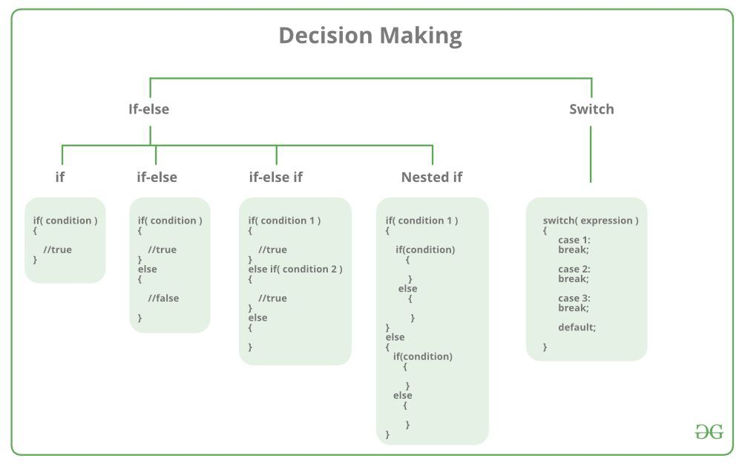
Decisions and loop - Making Decisions
Types of Decision Making statements
There are following types of Decision Making Statements
If statement
If-else statement
Elseif statement
Nested if statement
Switch statement
Image Source: https://media.geeksforgeeks.org/wp-content/cdn-uploads/20191202113149/CPP-Decision-Maki ng.png

Slide 7
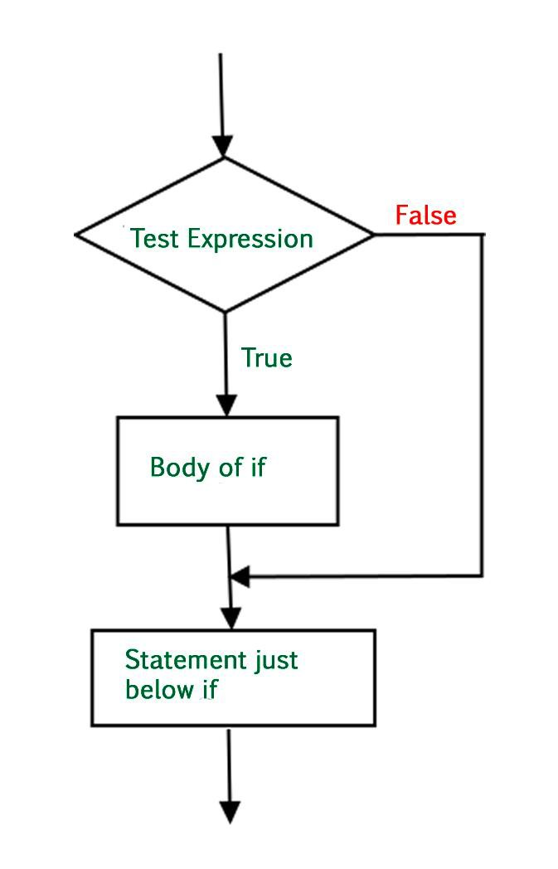
Decisions and loop - Making Decisions
if Statement
if statement is the most simple decision making statement.
if a certain condition is true then a block of statement is executed otherwise not.
Image Source: https://www.geeksforgeeks.org/php-decision-making/

Slide 8
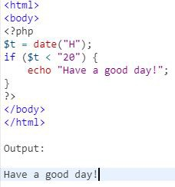
Decisions and loop - Making Decisions
if Statement (Continued)
Syntax:
if (condition){
// if TRUE then execute this code
}
Image Source: https://www.geeksforgeeks.org/php-decision-making/

Slide 9
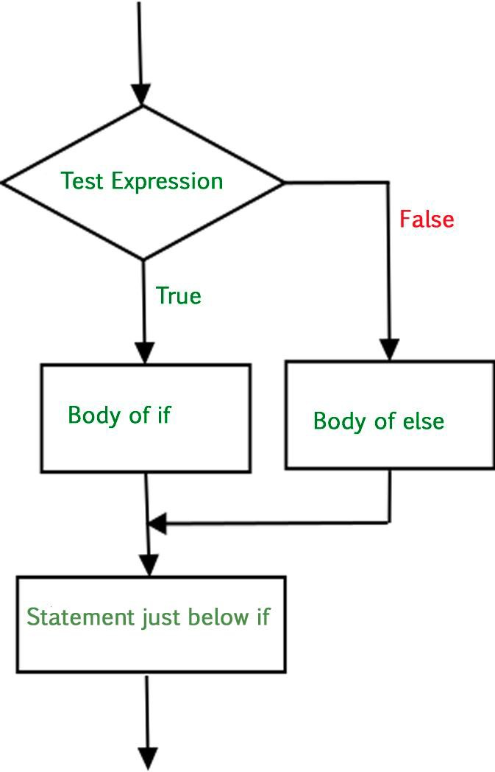
Decisions and loop - Making Decisions
if-else Statements
if-else statement is executed whether condition is true or false.
It executes one block of code if the specified condition is true
And another block of code executes if the condition is false.
Image Source: https://www.geeksforgeeks.org/php-decision-making/

Slide 10
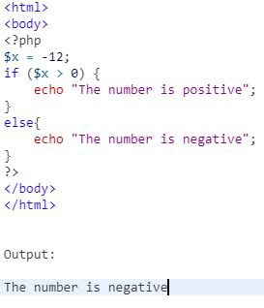
Decisions and loop - Making Decisions
if-else Statements (Continued)
Syntax:
if (condition) {
// if TRUE then execute this code
}
else{
// if FALSE then execute this code
}
Image Source: https://www.geeksforgeeks.org/php-decision-making/

Slide 11
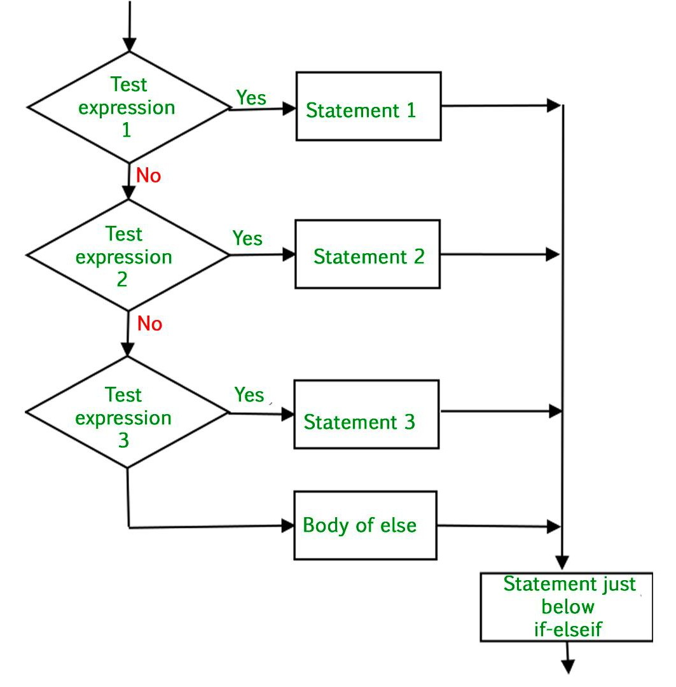
Decisions and loop - Making Decisions
else-if Statements
else-if statements is like another if condition, it's used when if statement having multiple decisions.
The if...elseif...else statement executes different codes for more than two conditions.
Image Source: https://www.geeksforgeeks.org/php-decision-making/

Slide 12
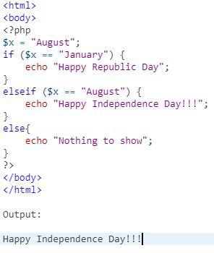
Decisions and loop - Making Decisions
Else-if Statements (Continued)
Syntax:
if (condition) {
// if TRUE then execute this code
}
elseif {
// if TRUE then execute this code
}
else {
// if FALSE then execute this code
}
Image Source: https://www.geeksforgeeks.org/php-decision-making/

Slide 13
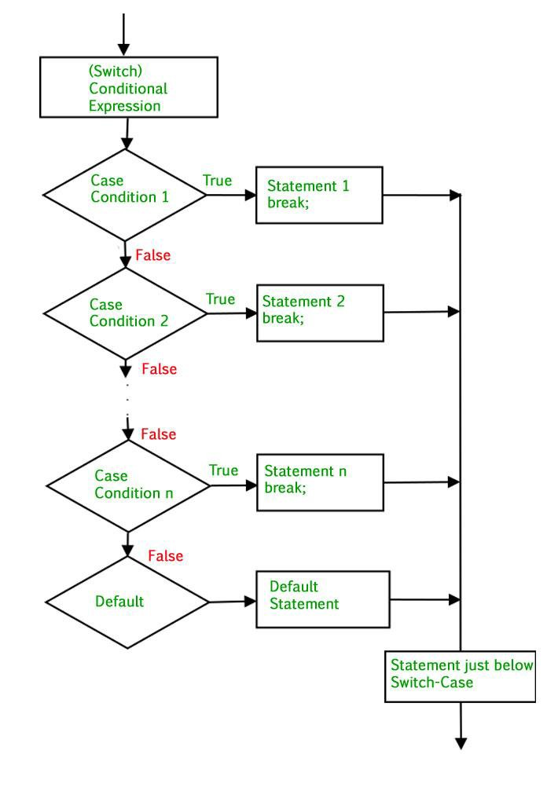
Decisions and loop - Making Decisions
Switch Statements
The switch statement is used to perform different actions based on different conditions.
Use break to prevent the code from running into the next case automatically.
The default statement is used if no match is found.
The switch statement is used to avoid long blocks of if..elseif..else code.
Image Source: https://www.geeksforgeeks.org/php-decision-making/

Slide 14
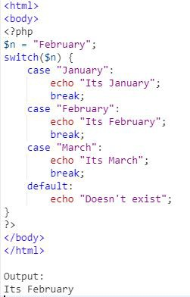
Decisions and loop - Making Decisions
Switch Statements (Continued)
Syntax:
switch(n) {
case statement1:
code to be executed if n==statement1; break;
default:
code to be executed if n != any case;
Image Source: https://www.geeksforgeeks.org/php-decision-making/

Slide 15
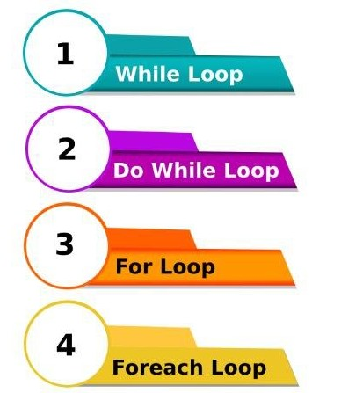
Doing Repetitive task with looping
Loop Statements
Loops are used to execute the same block of code a specified number of times.
There are four types of loops for ,forech
,while and do-while loop.
Image Source: https://cdn.educba.com/academy/wp-content/uploads/2020/02/different-types-of-Loops.jpg

Slide 16
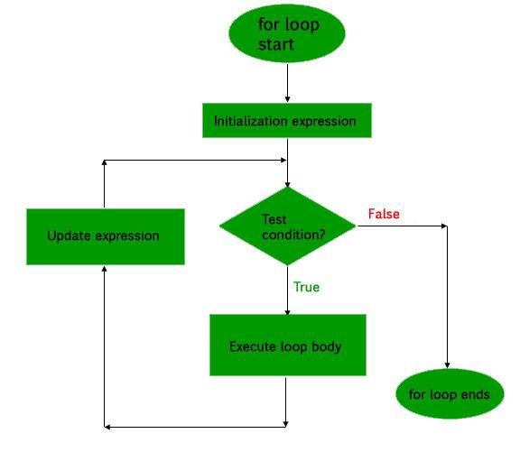
Doing Repetitive task with looping
For Loop
for loop is used when you know how many times you want to execute a statement or a block of statements.
There are three main parameters to the code, namely the initialization, the test condition and the counter.
Image Source: https://www.w3schools.com/php/php_looping_for.asp

Slide 17
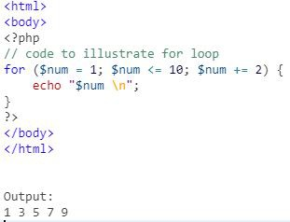
Doing Repetitive task with looping
For Loop (Continued)
Syntax:
for (initialization; condition; increment)
{
code to be executed;
}
Image Source: https://www.geeksforgeeks.org/php-loops/?ref=lbp

Slide 18
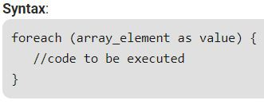
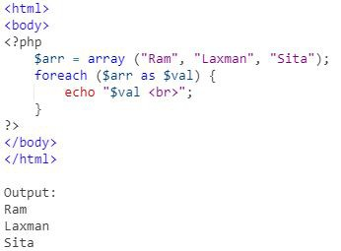
Doing Repetitive task with looping
Foreach Loop
Foreach loop is used to iterate over arrays.
For every counter of loop, an array element is assigned and the next counter is shifted to the next element.
Image Source: https://www.geeksforgeeks.org/php-loops/?ref=lbp

Slide 19
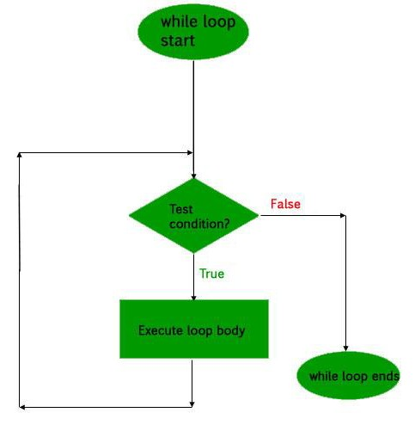
Doing Repetitive task with looping
While Loop
The while loop is also an entry control loop like for loops .
it first checks the condition.
If the condition true true then it enters the loop and executes the block of statements,
Image Source: https://www.geeksforgeeks.org/php-loops/?ref=lbp

Slide 20
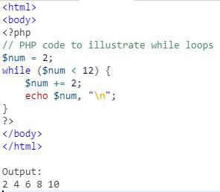
Doing Repetitive task with looping
While Loop (Continued)
Syntax:
while (if the condition is true) {
// code is executed
}
Image Source: https://www.w3schools.com/php/php_looping_while.asp

Slide 21
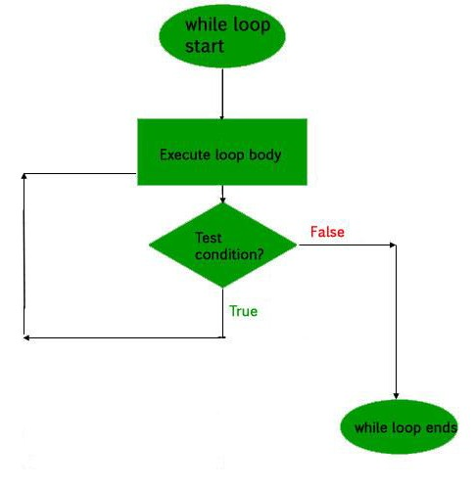
Doing Repetitive task with looping
Do-While Loop
The do-while loop will always execute the block of code once.
It will then check the condition, and repeat the loop while the specified condition is true.
Image Source: https://www.w3schools.com/php/php_looping_while.asp

Slide 22
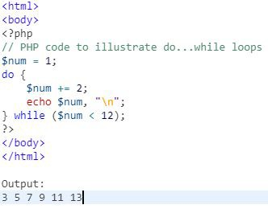
Doing Repetitive task with looping
Do-While Loop (Continued)
Syntax:
do {
//code is executed
} while (if condition is true);
Image Source: https://www.w3schools.com/php/php_looping_while.asp

Slide 23
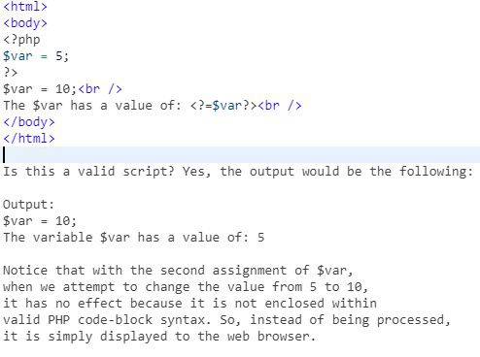
Mixing Decisions and looping with Html
Mixing Decisions and looping with Html
PHP will only processes things that are enclosed within one of its valid code blocks (such as <?php and ?>).
PHP effectively ignores everything that it was not specifically told to process
Image Source: http://shubhneet.com/mixing-decisions-and-looping-with-html/

Slide 24
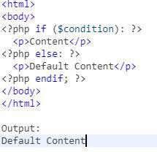
Mixing Decisions and looping with Html
PHP Conditions with HTML
Display a certain HTML code if the condition is true in PHP
PHP Condition is being used simply to control the output of standard HTML code
Image Source: http://shubhneet.com/mixing-decisions-and-looping-with-html/

Slide 25
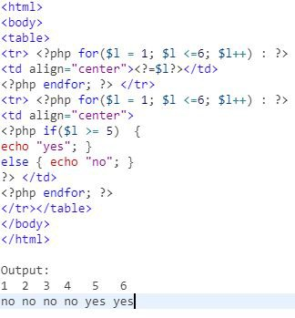
Mixing Decisions and looping with Html
Embedded Syntax in HTML
Beyond simple if statements, most control structures provide an alternative syntax .
That allows us to embed PHP code within standard HTML quickly and easily.
Image Source: http://shubhneet.com/mixing-decisions-and-looping-with-html/

Slide 26
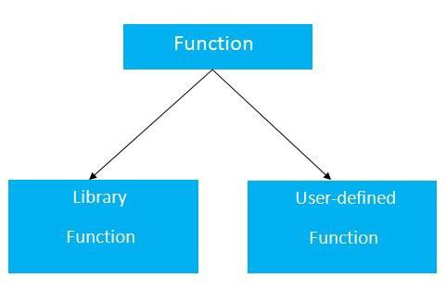
Function
Image Source: https://static.javatpoint.com/cpages/images/c-function.jpg

Slide 27
Function - What is a function?
What is a function?
A function is a block of statements that can be used repeatedly in a program.
It can take input as argument list and return value.
A function will not execute automatically when a page loads.
A function will be executed by a call to the function.
There are two types of functions 1.User-Defined functions
2. Built-in functions
Image Source: https://static.javatpoint.com/cpages/images/c-function.jpg

Slide 28
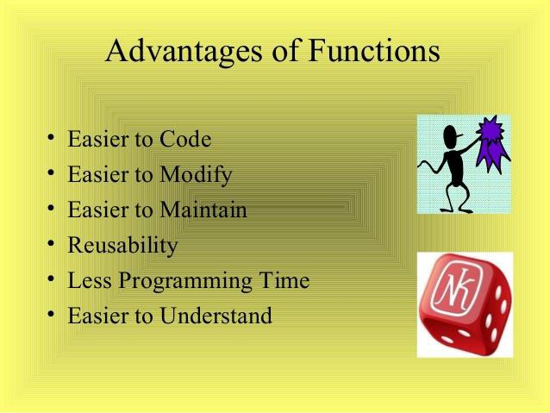
Function - What is a function?
Advantages of Functions
PHP Functions reduces the memory and complexity of the program.
Functions mainly helps in re-usability.
PHP Functions reduces the bugs and saves the time of programmer.
Information hiding is possible by functions.
Once the function execution is completed it returns to the position where it was called.
Image Source: https://image.slidesharecdn.com/badshahprogramming-160814063418/95/functions-in-c-ppt-6- 638.jpg?cb=1471156496

Slide 29
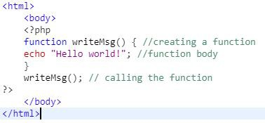
Function - What is a function?
Define a function
A user-defined function declaration starts with the word function:
A function name must start with a letter or an underscore.
Function names are NOT case-sensitive.
Image Source: https://www.w3schools.com/php/php_functions.asp

Slide 30
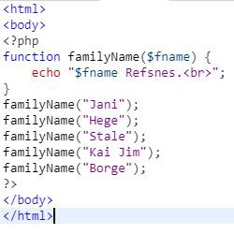
Function - What is a function?
User-Defined Function
User defined functions, which is built by the user based on the requirement.
function name must start with a letter or an underscore.
Information can be passed to functions through arguments.
Functions are called in two ways Call by Value and Call by reference
Image Source: https://www.w3schools.com/php/php_functions.asp

Slide 31
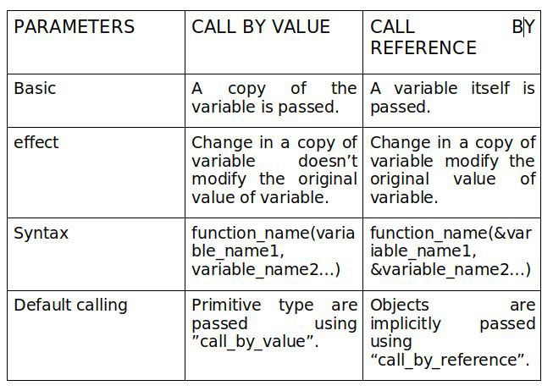
Function - What is a function?
Call by value vs Call by Reference
Functions are called in two ways They are
Call by Value
Call by reference
Image Source: https://freshlybuilt.com/call-by-reference-and-call-by-value-in-c-cpp/

Slide 32
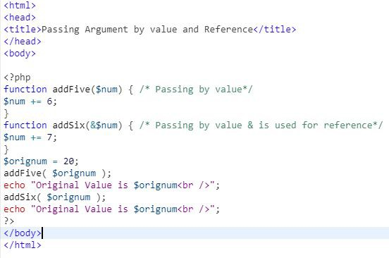
Function - What is a function?
Call by Value function
Call by value means passing the value directly to a function.
The called function uses the value in a local variable;
any changes to it do not affect the source variable.
Image Source: https://www.tutorialspoint.com/php/php_functions.htm

Slide 33
Function - What is a function?
Call by Reference function
Call by reference means passing the address of a variable where the actual value is stored.
The called function uses the value stored in the passed address;
any changes to it do affect the source variable.
In such case, we need to use & (ampersand) symbol with formal arguments.
Image Source: https://www.c-sharpcorner.com/UploadFile/d9da8a/call-by-value-and-call-by-reference-in-php/

Slide 34
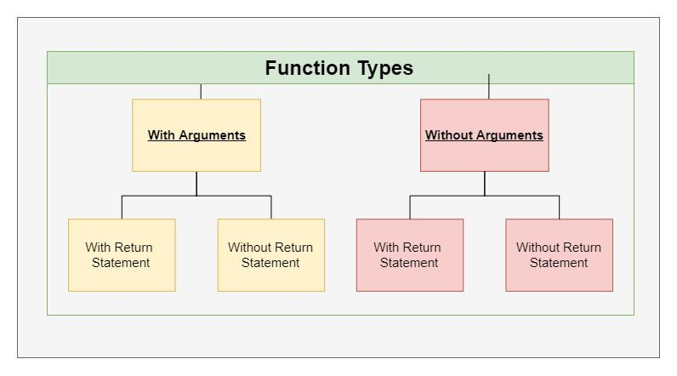
Function - What is a function?
Types of User Defined functions
Based on passing the arguments to the functions there different types of user defined functions.
Without Arguments
With Arguments
Without Return Value
With Return Value
Image Source: https://freshlybuilt.com/call-by-reference-and-call-by-value-in-c-cpp/

Slide 35
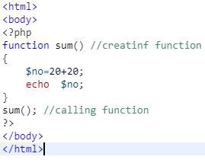
Function - What is a function?
Function without Parameters and Without return statement
The function without parameters does not contain any variables as arguments.
We can define all of the variables inside the function block.
No arguments passed to the function.
Image Source: https://freshlybuilt.com/call-by-reference-and-call-by-value-in-c-cpp/

Slide 36
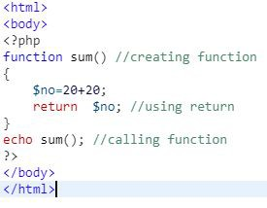
Function - What is a function?
Function without Parameters and With return statement
The function without parameters does not contain any variables as arguments.
We can define all of the variables inside the function block.
No arguments passed to the function.
The function returns the value using return statement.
Image Source: https://www.splessons.com/lesson/php-functions/

Slide 37
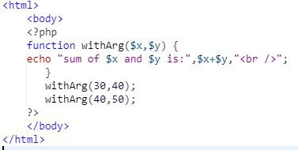
Function - What is a function?
Function with Parameters and Without return statement
The function with at least one parameter and it contain variables as arguments.
arguments passed to the function when it’s called.
Image Source: https://www.splessons.com/lesson/php-functions/

Slide 38
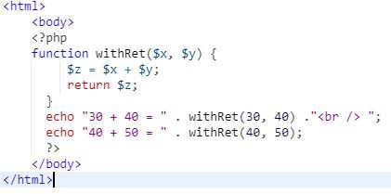
Function - What is a function?
Function with Parameters and return statement
The function with at least one parameter and it contain variables as arguments.
arguments passed to the function when it’s called.
Function will return the value.
Image Source: https://www.splessons.com/lesson/php-functions/

Slide 39
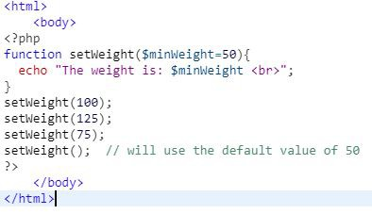
Function - What is a function?
Function with Default Parameter
If we call the function setWeight() without arguments it takes the default value as an argument.
If we call the function with argument it takes passed value as an argument.
Image Source: https://www.w3schools.in/php/functions/#PHP_Default_Argument_Value

Slide 40
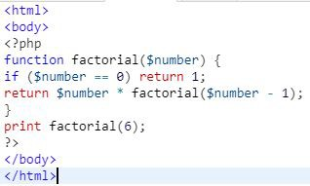
Function - What is a function?
Recursive Function (Continued)
The factorial
function is called
recursively in the example.
In each iteration returning value and finally calculating factorial of number.
Image Source: https://www.javatpoint.com/php-recursive-function

Slide 41
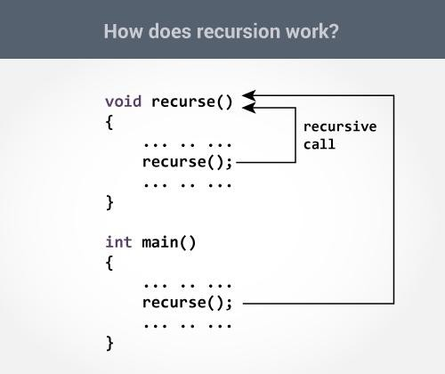
Function - What is a function?
Recursive Function
The recursive function is a function that calls itself during its execution.
This enables the function to repeat itself several times, outputting the result and the end of each iteration.
Image Source: https://www.javatpoint.com/php-recursive-function

Slide 42
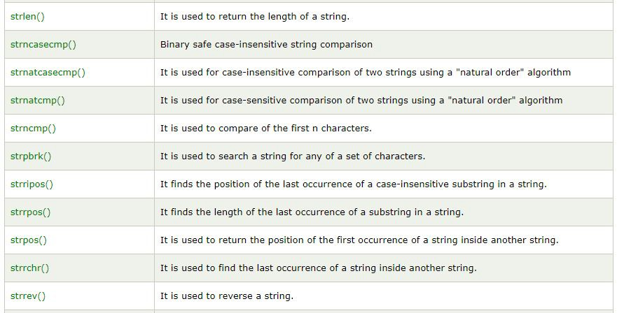
Function - What is a function?
Built-in Functions
The functions are also called as Library or Standard functions.
These functions are provided by the programmer.
We can use the functions directly.
Ex:echo(),sort(),print(),sprint(),..etc
Image Source: https://www.javatpoint.com/php-string-functions

Slide 43
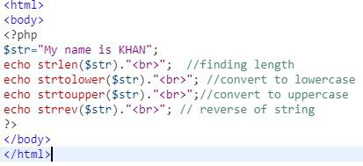
Function - What is a function?
Built-in Functions (Continued..)
The following library functions used for strings operations.
strrev()
strlen()
Strtolower()
Strtoupper()
echo()
Image Source: https://www.javatpoint.com/php-string-functions

Slide 44
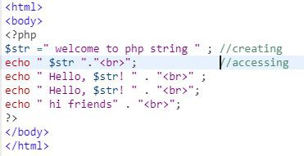
String
Image Source: https://www.javatpoint.com/php-string

Slide 45
String - Creating and accessing, String Searching & Replacing String
Creating a String
The string is nothing but, it’s just a Series of character.
Assigning the string to a variable.
PHP supports only 256-character set
Example: Tutorial, PHP, java language etc.
When a number is placed into the single or double quote then it’s also a string.
“Hello”,’1234’,”Welcome”
Image Source: https://www.javatpoint.com/php-string

Slide 46
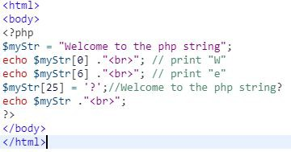
String - Creating and accessing, String Searching & Replacing String
Accessing a String
we can access the each characters of a string.
We can access particular character from a string with the help of index.
Image Source: http://shubhneet.com/creating-and-accessing-string/

Slide 47
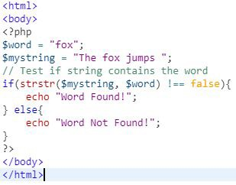
String - Creating and accessing, String Searching & Replacing String
Searching a String
Find out whether some text within a string or not, using function.
occurs strstr()
if string match print all the string from where string matched.
If the word is not found strstr function returns false.
Image Source: https://www.tutorialrepublic.com/faq/how-to-check-if-a-string-contains-a-specific-word-in-php.php

Slide 48
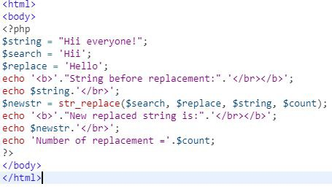
String - Creating and accessing, String Searching & Replacing String
Replacing a String
The str_replace(find,replace,string,count) function replaces some characters with some other characters in a string.
Find-specify the value
Replace-specify the replacing value
String-specify the string to be searched
Count-it is optional,specifies number of replacements.
Image Source: https://www.javatpoint.com/php-string-str_replace-function

Slide 49
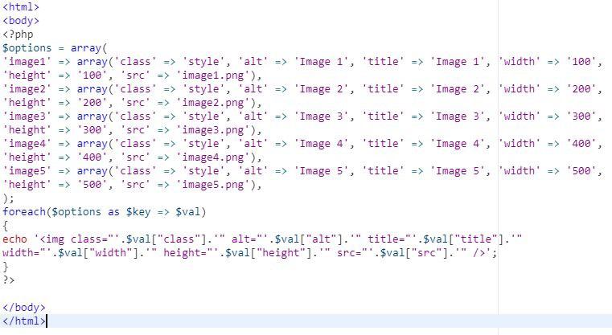
Formatting String ,String Related Library function
Formatting a String
Most of the we will use echo function display the string.
the echo syntax to output the image tags
With the different single and double quotes it becomes really hard to read.
The solution is to PHP built-in functions sprintf () and printf() to create a formatted string to output in the HTML.
printf() will echo the string directly.
sprintf() function will return a formatted string.
Image Source: https://www.elated.com/formatting-php-strings-printf-sprintf/

Slide 50
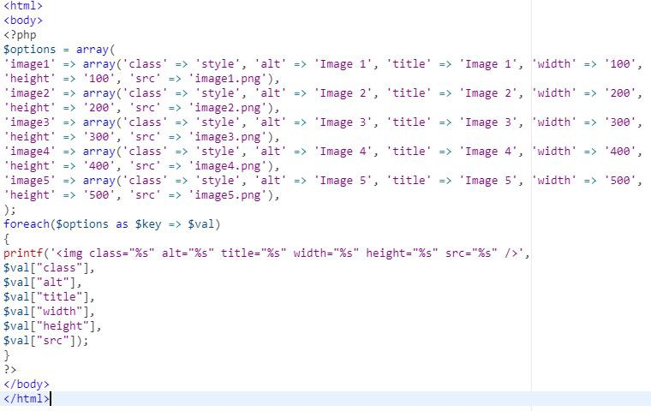
Formatting String ,String Related Library function
Formatting a String (Continued)
The printf() function outputs a formatted string.
printf() will output the string directly like echo.
Image Source: https://www.elated.com/formatting-php-strings-printf-sprintf/

Slide 51
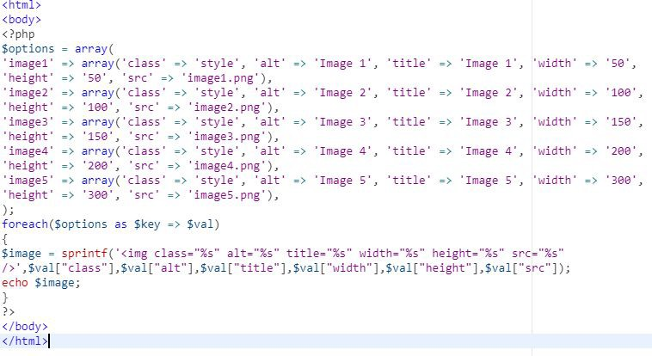
Formatting String ,String Related Library function
Formatting a String (Continued)
The sprintf() is an in-built function of PHP which writes a formatted string to a variable.
It returns a formatted string.
PHP 4 and above versions support sprintf() function.
Image Source: https://www.elated.com/formatting-php-strings-printf-sprintf/

Slide 52
Formatting String ,String Related Library function
String Related Library Function
PHP provides various string Library functions to access and manipulate strings.
A list of PHP string functions are given below.
Strtolower() , strtoupper() , strtr() , substr() etc..,
Image Source: https://www.w3schools.com/php/php_string.asp

Slide 53
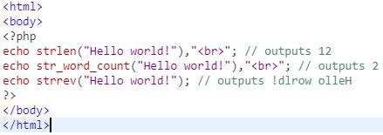
Formatting String ,String Related Library function
String Related Library Function (Continued)
The PHP strlen() function returns the length of a string.
The PHP str_word_count() function counts the number of words in a string.
The PHP strrev() function reverses a string.
Image Source: https://www.w3schools.com/php/php_string.asp

Slide 54
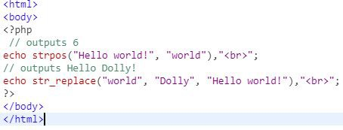
Formatting String ,String Related Library function
String Related Library Function (Continued)
The PHP strpos() function searches for a specific text within a string
The PHP str_replace() function replaces some characters with some other characters in a string.
Image Source: https://www.w3schools.com/php/php_string.asp

Slide 55
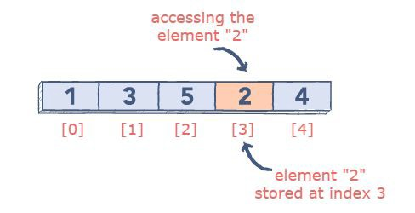
Array
Image Source: https://www.educative.io/edpresso/what-are-numeric-arrays-in-php

Slide 56
Array - Anatomy of an Array
What is an Array?
An array is a data structure that stores one or more similar type of values in a single value.
Each array value is accessed using an ID which is called array index.
By default the index always starts at
Image Source: https://www.educative.io/edpresso/what-are-numeric-arrays-in-php
zero.

Slide 57
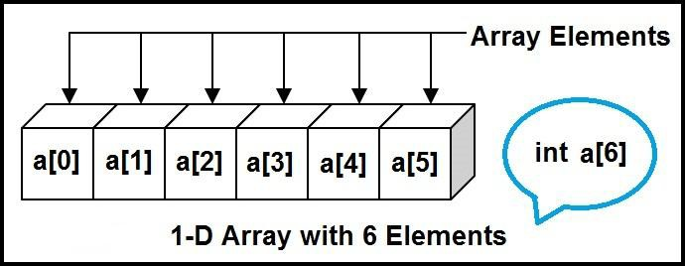
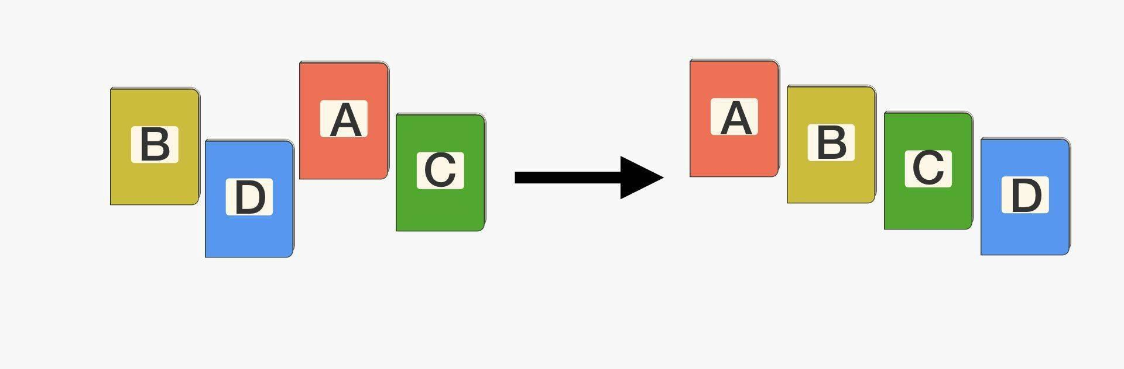

Array - Anatomy of an Array
Advantages of arrays
Array can store multiple values within a
single variable.
The values of an array can be sorted easily.
we can traverse all the elements of an array.
Searching for an element is with arrays.
There are more than 100 Library
functions are there for arrays.
Image Source: https://www.educative.io/edpresso/what-are-numeric-arrays-in-php

Slide 58


Array - Anatomy of an Array
Declaration of Array
An array is a data structure that stores one or more similar type of values in a single value.
Each array value is accessed using an ID c which is called array index.
There are three different kind of arrays
Numeric Arrays ,Associative Arrays and
Multidimensional Arrays.
Image Source: https://www.tutorialspoint.com/php/php_arrays.htm

Slide 59

Creating index based and Associative array
Types of Arrays
There are three different kind of arrays
Numeric Arrays -An array with a numeric index.
Associative Arrays-An array with strings as index.
Multidimensional Arrays-An array
containing one or more arrays and values are accessed using multiple indices
Image Source: https://www.educba.com/arrays-in-php/

Slide 60
Creating index based and Associative array
Index based Array
These arrays can store numbers and strings.
The index will be represented by numbers.
By default array index starts from zero.
array() function is used to create an array.
Image Source: https://www.tutorialspoint.com/php/php_arrays.htm

Slide 61

Creating index based and Associative array
Associative Array
The associative arrays are very similar to numeric arrays in term of functionality.
But they are different in terms of their index.
Associative array will have their index as string.
Image Source: https://www.tutorialspoint.com/php/php_arrays.htm

Slide 62

Creating index based and Associative array
Multi-Dimensional Array
A multi-dimensional array each element in the main array can also be an array.
And each element in the sub-array can be an array.
Values in the multi-dimensional array are accessed using multiple index.
Image Source: https://www.tutorialspoint.com/php/php_arrays.htm

Slide 63

Accessing array Element
Accessing Array Elements
An indexed array using loops in PHP.
We can use loop through the indexed array in two ways.
First by using for loop and secondly by using foreach loop.
Image Source: https://www.geeksforgeeks.org/php-arrays/

Slide 64
Looping with Index based array
Accessing index based Array using Loop
An indexed array accessing by using loops.
We can use loops for index based array in two ways.
First by using for loop and secondly by using foreach.
Image Source: https://www.geeksforgeeks.org/php-arrays/

Slide 65

Looping with associated array using each() and for each()
Looping with associated array using each()
The each() function is an inbuilt function in PHP
It is used to get the current element key-value pair of the given .
After returning the key and value of the current element pointer is incremented by one in the array.
Image Source: https://www.geeksforgeeks.org/php-each-function/

Slide 66

Looping with associated array using each() and for each()
Looping with associated array using foreach()
The foreach loop is mainly used for looping through the values of an array.
It loops over the array, and each value for the current array element is assigned to $value.
The array pointer is advanced by one to
Image Source: https://www.geeksforgeeks.org/iterate-associative-array-using-foreach-loop-in-php/
go the next element in the array.

Slide 67

Some useful Library functions
Library functions for Arrays
The Library functions allow you to access and manipulate arrays.
Simple and multi-dimensional arrays are supported.
There 60 functions that can support for arrays in PHP.
Example: sizeof() , sort() , usort() …, etc
Image Source: https://teamtreehouse.com/library/sorting-arrays

Slide 68

Some useful Library functions
Library functions for Arrays (Continued)
sizeof($arr) function returns the size of the array or the number of data elements stored in the array.
Image Source: https://www.studytonight.com/php/php-array-functions

Slide 69

Some useful Library functions
Library functions for Arrays (Continued)
is_array($arr) is to check whether the provided data is in form of an array,
It returns True if the variable is an array and returns False otherwise.
Image Source: https://www.studytonight.com/php/php-array-functions

Slide 70

Some useful Library functions
Library functions for Arrays (Continued)
in_array($var, $arr) is used to check whether a certain value is present in the array or not.
Image Source: https://www.studytonight.com/php/php-array-functions

Slide 71

Some useful Library functions
Library functions for Arrays (Continued)
print_r($arr) is a function to print the array in the most descriptive way possible.
This function prints the complete representation of the array, along with all the keys and values.
Image Source: https://www.studytonight.com/php/php-array-functions

Slide 72

Some useful Library functions
Library functions for Arrays (Continued)
array_merge($arr1, $arr2) is to combine two different arrays into a single array.
It can combine same type(indexed, associative etc) or different types of arrays into one single array.
Image Source: https://www.studytonight.com/php/php-array-functions

Slide 73

Some useful Library functions
Library functions for Arrays (Continued)
In an array, data is stored in form of key-value pairs, where key can be numerical or strings.
If we want to take all the values from our array, without the keys.
And store them in a separate array, then we can use array_values() function.
Image Source: https://www.studytonight.com/php/php-array-functions

Slide 74

Some useful Library functions
Library functions for Arrays (Continued)
array_keys($arr) is function to extract extract the keys from an array.
Image Source: https://www.studytonight.com/php/php-array-functions

Slide 75

Some useful Library functions
Library functions for Arrays (Continued)
array_pop($arr) removes the last element of the array.
Hence it can be used to remove one element from the end.
Image Source: https://www.studytonight.com/php/php-array-functions

Slide 76

Some useful Library functions
Library functions for Arrays (Continued)
array_push($arr, $val) function is the opposite of the array_pop() function.
This can be used to add a new element at the end of the array.
Image Source: https://www.studytonight.com/php/php-array-functions

Slide 77

Some useful Library functions
Library functions for Arrays (Continued)
array_shift($arr) is used to remove/shift the first element out of the array.
So, it is just like array_pop() function but different in terms of the position of the element removed.
Image Source: https://www.studytonight.com/php/php-array-functions

Slide 78

Some useful Library functions
Library functions for Arrays (Continued)
sort($arr) function sorts the array elements in ascending order.
In case of a string value array, values are sorted in ascending alphabetical order.
Some other sorting functions are: asort(), arsort(), ksort(), krsort() and rsort().
Image Source: https://www.studytonight.com/php/php-array-functions

Slide 79

Some useful Library functions
Library functions for Arrays (Continued)
Array_flip($arr) is function to interchange the keys and the values of a PHP associative array.
Image Source: https://www.studytonight.com/php/php-array-functions

Slide 80

Some useful Library functions
Library functions for Arrays (Continued)
array_reverse($arr) function is used to reverse the order of elements.
Making the first element last and last element first.
And similarly rearranging other array elements
Image Source: https://www.studytonight.com/php/php-array-functions

Slide 81

Some useful Library functions
Library functions for Arrays (Continued)
array_rand($arr) function is used to pick random data element from an array.
This function randomly element from the given returns it.
selects one array and
In case of indexed array, it will return the index of the element,
In case of associative array, it will return the key of the selected random element.
Image Source: https://www.studytonight.com/php/php-array-functions

Slide 82

Some useful Library functions
Library functions for Arrays (Continued)
array_slice($arr, $offset, $length)
function any array.
is used to create a subset of
Using this function, we define the starting point($offset, which is the array index from where the subset starts).
The length(or, the number of elements required in the subset starting from the
Image Source: https://www.studytonight.com/php/php-array-functions
offset).

Slide 83

Some useful Library functions
Library functions for Arrays (Continued)
Array_unique() function is used to remove duplicate values from an array.
Image Source: https://www.w3schools.com/php/func_array_unique.asp

Slide 84

Some useful Library functions
Library functions for Arrays (Continued)
Array_search($value,$array) function used to search an array for the value and return its key
Image Source: https://www.w3schools.com/php/func_array_search.asp

Slide 85

Some useful Library functions
Library functions for Arrays (Continued)
The each() function is an inbuilt function used to get the current element key-value which the internal pointer is currently pointing.
After returning the key and value of the current element the internal pointer is incremented by one in the array.
Image Source: https://www.w3schools.com/pHP/func_array_each.asp

Slide 86

Working with File and Directories – Understanding File & Directory
Image Source:
https://www.etutorialspoint.com/index.php/16-how-to-get-current-filename-directory-linenumber-in-php

Slide 87

Working with File and Directories – Understanding File & Directory
Reading the Contents of a Directory
Three functions to perform this task: opendir(), readdir() and closedir().
Note that readdir() returns only the names of its items, rather than full paths.

Slide 88

Working with File and Directories – Understanding File & Directory
File Opening Modes
A file can be opened in read-only mode or in reading and write modes.
Image Source: https://www.slideshare.net

Slide 89

Opening and closing a file
Opening a File
To open a file PHP you can use the fopen() function.
This function takes two parameters, where the first parameter contains the name of the file and the second parameter is the mode that should be used to open the file.

Slide 90

Copying, renaming and deleting a file
PHP copying a file
To copy a file, you use the copy() function.
The copy() function returns true if the file was copied successfully, otherwise, it returns false.

Slide 91

Coping, renaming and deleting a file
PHP renaming a file
To rename a file, you use the rename () function.
This function also allows you to move a
file to a different directory.

Slide 92

Coping, renaming and deleting a file
PHP deleting a file
To delete a file, you use the unlink() function.
You need to pass the file name that you want to delete to the unlink() function.
The function returns true on success or false on failure.

Slide 93

Working with directories
Reading the Contents of a Directory
Three functions to perform this task: opendir(), readdir() and closedir().
Note that readdir() returns only the names of its items, rather than full paths.

Slide 94

Working with directories
Deleting the Directory and Its Contents
PHP has the rmdir( ) function that takes a directory name as its only parameter.
It will remove the specified directory from the file system if the process running your script has the right to do so.
However, the rmdir() function works only on empty directories.

Slide 95

Working with directories
Creating New Directories
Using the mkdir() function, which takes
two parameters.
These parameters are, in order, a directory name you want to create and a
permission mode for a new directory, which must be an octal number.
The mode parameter is optional and has an effect only on Unix systems.

Slide 96

Text editor File

Slide 97

Building a text editor File Uploading & Downloading
Building a text editor File
The first thing that must be done is define the file(s).
An array is used so that both files can be identified and called through $files and later through the $file.
A value is being defined which will help pull the text from the respective submit buttons in the form fields.

Slide 98

Building a text editor File Uploading & Downloading
Upload a file to server
$_FILES array is used to upload files.
Image Source:
https://www.etutorialspoint.com/index.php/16-how-to-get-current-filename-director

Slide 99

Building a text editor File Uploading & Downloading
Download files in PHP
The Content-Disposition header function is used in PHP to supply a recommended filename and force the browser to display the save dialog.
Before downloading the files, file types are checked.
Image Source: https://www.tutorialexample.com

Slide 100

Using query string (URL rewriting)
Passing a query string to a page
There are two ways to pass a QueryString to a page, the first is to enter it manually.
An alternative, and perhaps more useful, the way is to use HTML forms.
The main thing to remember with forms is that you need to use the GET method to send information via the query string.

Slide 101

Using query string (URL rewriting)
Accessing a query string element in a PHP page
In PHP, all the information passed via the query string is held in the $_GET super global array.
To access an item, type
$_GET[‘varName’], where varName is the name of the variable in the query string.

Slide 102

Using Hidden field
Using Hidden field
A hidden field is not shown on the page.
It simply keeps the text value specified in the value attribute.
Hidden fields are good for passing additional information from the form to the server.

Slide 103

Using cookies
Using cookies, The Anatomy of a cookie
Cookies are text files stored on the client computer and they are kept of use tracking purpose.
PHP transparently supports HTTP cookies.
Cookies are usually set in an HTTP header.
Image Source: https://www.sitesbay.com/php/php-cookies-in-php

Slide 104

Using cookies
Setting Cookies with PHP
PHP provided setcookie() function to set a cookie.
This function requires up to six arguments and should be called before
<html> tag.
For each cookie, this function has to be
called separately.

Slide 105

Using cookies
Accessing Cookies with PHP
PHP provides many ways to access cookies. The simplest way is to use is
$_COOKIE variables.

Slide 106

Using cookies
Deleting Cookie with PHP
To delete a cookie you should call setcookie() with the name argument only.
It is safest to set the cookie with a date that has already expired.

Slide 107

Using session
Using Session
An alternative way to make data accessible across the various pages of an entire website is to use a PHP Session.
A session creates a file in a temporary directory on the server where registered session variables and their values are stored.
Image Source: http://phpdeveloper.org

Slide 108
Using session
Starting a PHP Session
The session_start () function is used to start a PHP session.
It is recommended to put the call to session_start () at the beginning of the page.
Image Source: http://phpdeveloper.org

Slide 109
Using session
Destroying a PHP Session
A PHP session can be destroyed by session_destroy() function.
to destroy a single session variable, unset() function is used to unset a session variable.
Image Source: http://phpdeveloper.org

Slide 110

String matching with regular expression
Image Source:
http://crackcoder.blogspot.com/2016/02/all-about-intro-regular-expressions-php.html

Slide 111

String matching with regular expression
What is a regular expression ?
Regular expressions are a powerful tool for examining and changing the text.
They enable you to search for patterns within a string, extracting matches flexibly and precisely.
Image Source:
http://crackcoder.blogspot.com/2016/02/all-about-intro-regular-expressions-php.html

Slide 112

String matching with regular expression
Basics of regular expression
Some characters have special meanings in regular expressions.
The characters that match themselves are called literals.
The characters that have special meanings are called metacharacters.

Slide 113

Pattern matching in PHP
Pattern matching in PHP
The preg_match() function performs Perl-style pattern matching on a string.
preg_match() takes two basic and three optional parameters.
preg_match ( pattern, subject [, matches [, flags [, offset]]])
The preg_match() function returns 1 if a match is found and 0 otherwise.

Slide 114

Replacing text
Replacing text
The preg_replace() function looks for substrings that match a pattern and then replaces them with new text.
preg_replace() takes three basic parameters and an additional one.
preg_replace( pattern, replacement, subject [, limit ])

Slide 115

Splitting a string with a Regular Expression
Splitting with Preg_Split()
It will split a string, but it will allow you to use variable delimiters
It makes easy to extract interesting bits of text with unwanted (but specifiable) gunk in the middle.
Image Source: https://www.geeksforgeeks.org/php-preg_split-function/

Slide 116

Splitting a string with a Regular Expression
Splitting without Losing
To split a string without removing anything from it, we use a flag: PREG_SPLIT_DELIM_CAPTURE.
This flag inserts any captured groups into the array.

Slide 117

Splitting a string with a Regular Expression
Splitting with an Invisible Delimiter
The preg_split function allows you to split a string with an invisible delimiter.

